Slide 1




Knowledge systems for Climate
Peter Murray-Rust
University of Cambridge and https://semanticClimate.org
Guterres: IPCC Report is “Survival Guide for Humanity”
https://unsdg.un.org/latest/stories/new-un-report-offers-survival-guide-humanity-face-climate-change
TiB 2023-10-23, Online

Slide 2
2019 TIGR2ESS
2020 openVirus
2021 invasive species
2022 semanticClimate

Slide 3
Knowledge systems,Tools, resources
15,000 pages of PDF-EN Reports transformed to citizen-friendly semantic resources
Semantic IPCC Glossary , 1500 terms with Wikidata multilingual equivalents
Supervised search of Scholarly Open literature (pygetpapers/docanalysis) -> medium-grained semantics
Wikibase for searching resources (SPARQL)
Demo:
Knowledge graph for glossary (CSV triples,
Wikibase for Chapters + SPARQL
URLs: https://semanticclimate.org/, https://github.com/petermr/semanticClimate

Slide 4
7 IPCC REPORTS https://github.com/petermr/semanticClimate/blob/main/ipcc/ar6/fsci_slides/Waheb_presentation.pptx
WG1
IPCC/ar6/wg1 report with 12 chapters
The title is "Climate Change 2021: The Physical Science Basis"
WG2
IPCC/ar6/wg2 report with 18 chapters
The title is "Climate Change 2022: Impacts, Adaptation and Vulnerability"
WG3
IPCC/ar6/wg3 report with 17 chapters
The title is "Climate Change 2022: Mitigation of Climate Change"
SYR AR6 Synthesis Report 2023 (SYR)
SR15
SPECIAL REPORT on Global Warming of 1.5 ºC
SRCCL
SPECIAL REPORT on Climate Change and Land
SROCC
Special Report on the Ocean and Cryosphere in a Changing Climate
https://semanticclimate.org/p/en/posts/resources/

Slide 5
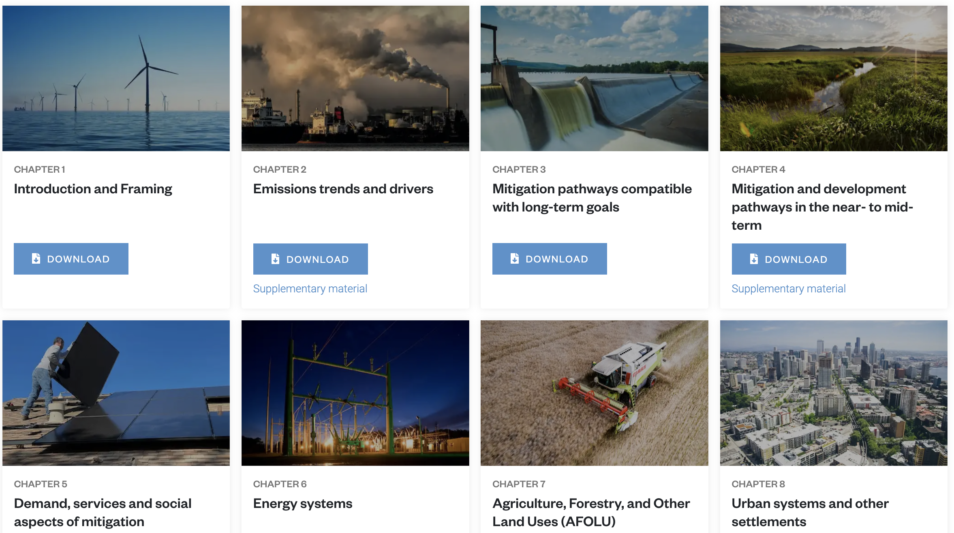
IPCC AR6/WG3 17 Chapters
One chapter per person
IPCC: 15,000 pages of PDF

Slide 6
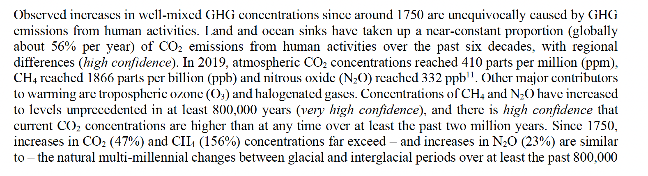
PDF Statements in SYR (several hundred)

Slide 7
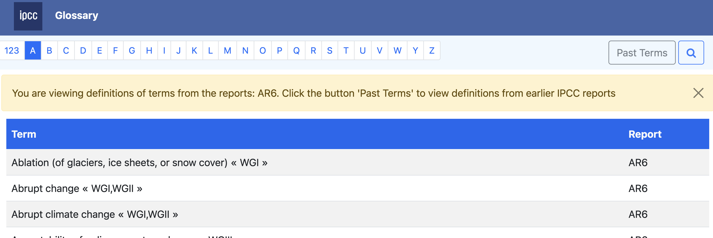
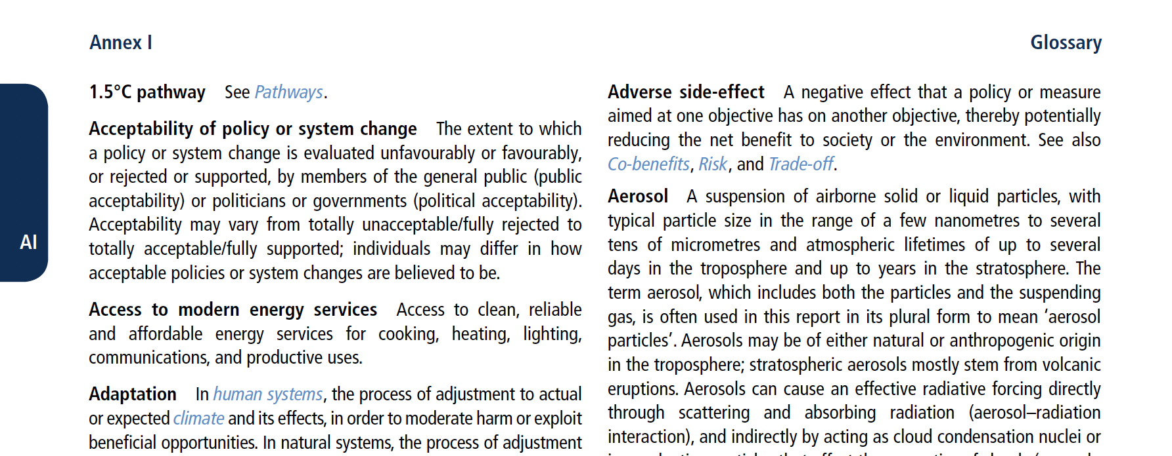
IPCC Glossary
Central
Per-chapter

Slide 8
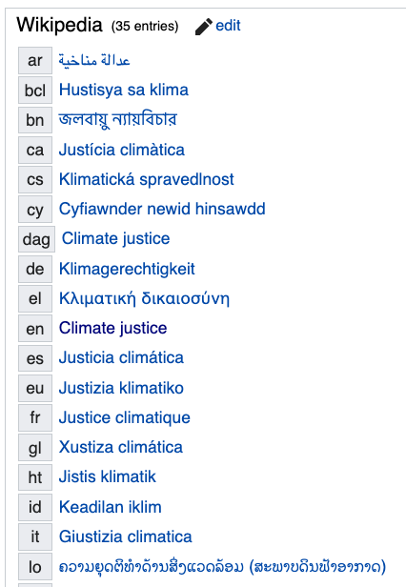
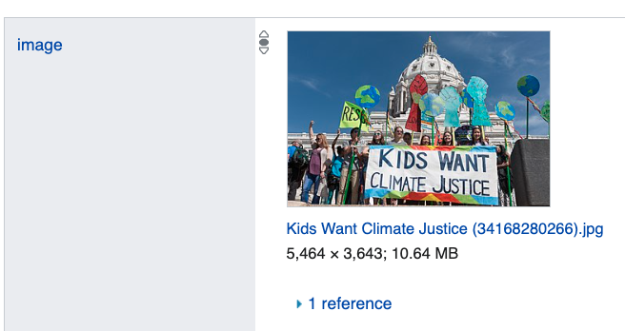

“Climate Justice?”
answers in
Wikipedia and Wikidata
The Scholarly Literature

Slide 9
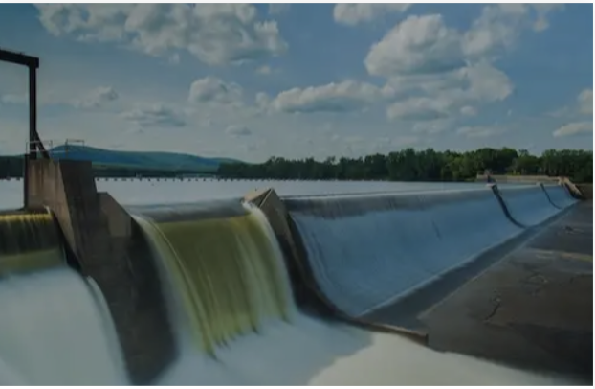

SemanticClimate – what we do
NLP/ML/AI
20,000 pp
OA repos
Search
mini-Corpus
Semantic
Literature
Dictionaries
IPCC/AR6
Learning

Slide 10
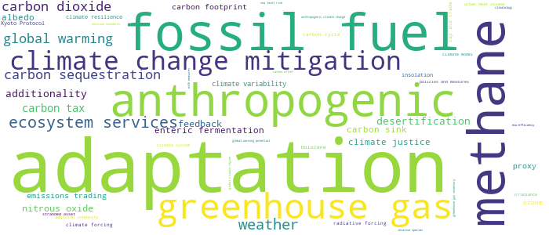
6 Chapters of IPCC WG3
Demo link
{'adaptation': 286, 'fossil fuel': 111, 'methane': 107, 'anthropogenic': 83, 'greenhouse gas': 81, 'climate change mitigation': 66, 'ecosystem services': 48, 'weather': 44, 'carbon sequestration': 35, 'global warming ': 33, 'carbon dioxide': 33, 'carbon tax': 21, 'desertification’: …}
#SemanticClimate’s Climate Knowledge Hunt
docanalysis unsupervised
Climate justice!
@ShweataNHegde

Slide 11
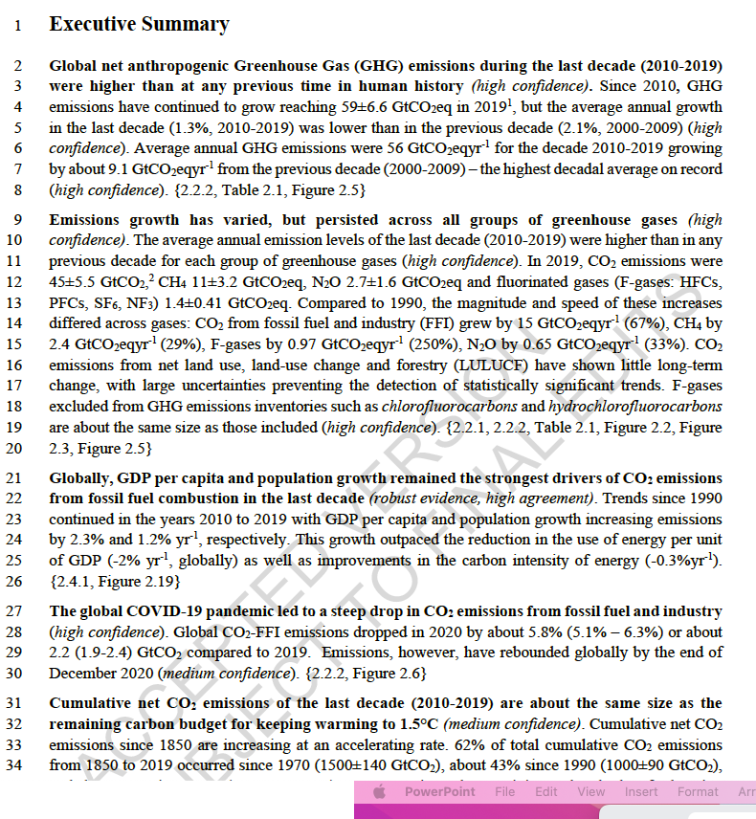
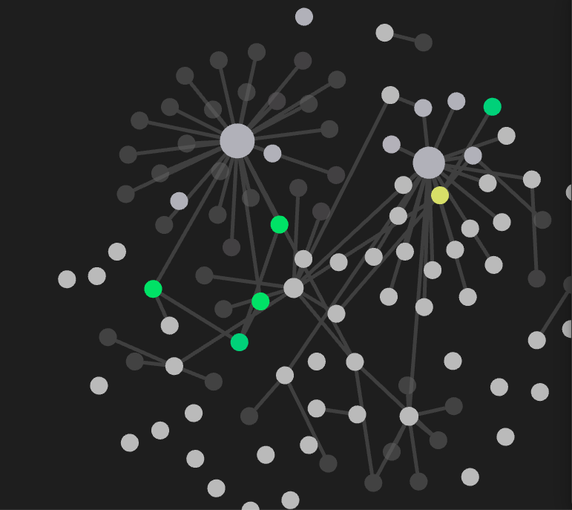
IPCC Knowledge Graph
~500,000 Links
2_exec_1
2_exec_2
Paragraphs
2_exec_3
Links to other
chapters
2_exec_4

Slide 12
Demo:
Glossary (CSV triples) https://github.com/petermr/semanticClimate/blob/main/ipcc/ar6/test/total_glossary/parents.csv
Glossary Knowledge graph (pyvis) @ShweataNHegde
https://github.com/petermr/semanticClimate/blob/main/ipcc/ar6/test/ipcc_glossary.html
Wikibase for Chapters + SPARQL
https://kg-ipclimatec-reports.wikibase.cloud/wiki/Main_Page
(thanks Egon+Lars Willighagen, @egonw)

Slide 13
The future
We are taking the knowledge system to IPCC Geneva in 2 weeks time
Collaboration with anyone, not control [0]
Tools, not original content
Citizen-friendly, not competitive
Crisis oriented, not academic [1]
[0] Wikimedia Deutschland, CODATA, FORCE-11, UN-Library, UniGE, INYAS, KARYA, NIPGR,
[1] https://www.nytimes.com/2015/04/08/opinion/yes-we-were-warned-about-ebola.html,
“The road to inaction is paved with research papers.”

